Slide 1




UX AUDIT REPORT
FEBRUARY 2024
High level expert review
Heuristic evaluation & user interviews

Slide 2
1. INTRODUCTION - What we did
Executive Summary
Goals and objectives
2. METHODOLOGY- Process and Methods
Nielsen's Heuristic Evaluation
Ben Shneiderman’s 'Eight Golden Rules of Interface Design
Arnold Lund's 34 Usability Maxims
Norman's Theory of Action
Web3 Design Audit Checklist Based on Web3 Design Principles by Beltran
3. FINDINGS - What we tested on
Recommendations
4. INSIGHTS AND NEXT STEPS - What we tested on
Recommendations
In this report

Slide 3

UMBRIA
UX AUDIT REPORT
INTRODUCTION

Slide 4
EXECUTIVE SUMMARY
In this comprehensive UX audit, we conducted an expert review of Umbria user experience based on Web3 usability guidelines and expert review checkpoints. The aim was to assess the platform's alignment with industry best practices, ensuring a seamless and user-centric experience for all users interacting with Web3 technologies.
Our review focused on evaluating critical aspects such as platform accessibility, navigation, search functionality, user education, error handling, and the integration of Web3 wallet functionalities. Through a meticulous assessment, we identified several areas that require immediate attention to enhance the overall user experience.

Slide 5
247 WEB USABILITY GUIDELINES
This review focused on evaluating critical aspects such as platform accessibility, navigation, search functionality, user education, error handling, etc. Through a meticulous assessment, we identified several areas that require immediate attention to enhance the overall user experience.
UX PRINCIPLES | COMPLIES | DOESN’T COMPLY | NOT APPLICABLE | COMPLIANCE RATE
Home Page | 13 Criteria | None | None | 100%
Task orientation | 16 Criteria | 4 Criteria | 3 Criteria | 76%
Navigation and IA | 18 Criteria | None | 1 Criteria | 100%
Forms and data entry: | 12 Criteria | None | 4 Criteria | 100%
Trust and credibility | 8 Criteria | None | None | 100%

Slide 6
UX PRINCIPLES | COMPLIES | DOESN’T COMPLY | NOT APPLICABLE | COMPLIANCE RATE
Writing and content quality | 16 Criteria | 1 Criteria | 2 Criteria | 94%
Page layout and visual design: | 29 Criteria | 4 Criteria | 1 Criteria | 87%
Search usability | None | None | 16 Criteria | 0%
Help, feedback and error tolerance | 21 Criteria | 3 Criteria | 1 Criteria | 87%
Total | 133 Criteria | 13 Criteria | 28 Criteria | 91%

Slide 7
REVIEW BASED ON WEB3 UX PRINCIPLES
By Beltran
This review focused on evaluating critical aspects involved in the integration of Web3 wallet functionalities.
UX PRINCIPLES | COMPLIES | DOESN’T COMPLY | NOT APPLICABLE | COMPLIANCE RATE
Transparency of Data provenance | 1 Criteria | 3 Criteria | None | 33%
Transparency of Transactions | 6 Criteria | 1 Criteria | 1 Criteria | 85%
Transparency of Smart Contract | 1 Criteria | 1 Criteria | 1 Criteria | 50%
Transparent User interaction History | 1 Criteria | 2 Criteria | None | 33%
Transparency of Code | 3 Criteria | 3 Criteria | 1 Criteria | 50%

Slide 8
UX PRINCIPLES | COMPLIES | DOESN’T COMPLY | NOT APPLICABLE | COMPLIANCE RATE
Human Readable Hashes Format | 1 Criteria | 3 Criteria | None | 25%
Time/Wait Management | 2 Criteria | None | None | 100%
Permanent Newbie Mode | 1 Criteria | 2 Criteria | None | 33%
Gas Price and Transaction Reversal | 0 Criteria | 2 Criteria | 1 Criteria | 0%
Sense of Community | 4 Criteria | None | None | 100%
Total | 20 Criteria | 17 Criteria | 4 Criteria | 54%

Slide 9
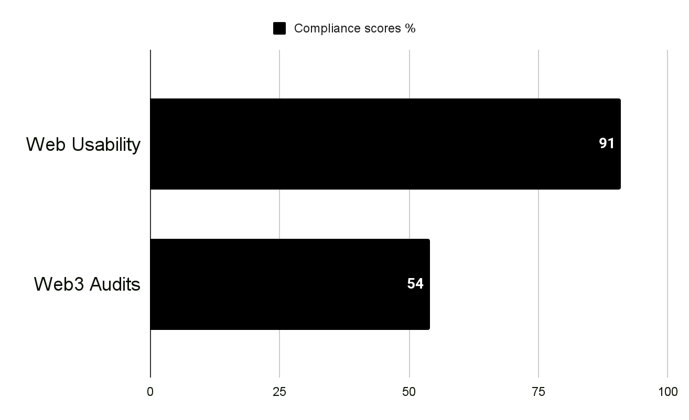
USABILITY STATS
Overall Compliance percentage
Usability Score
GOOD
83.6%
Users should be able to use this site or system with relative ease and should be able to complete the vast majority of important tasks.
Overall Compliance
Overall non compliance
153/183
30/183

Slide 10
PRODUCT OVERVIEW
The Umbria ecosystem acts as a platform, for moving funds freely between cryptocurrency networks, and for trading those assets in one place.
CONTEXT OF THE AUDIT
This study involved collecting a rich research database consisting of detailed observations and findings based on Nielsen's Heuristic Evaluation,
Design Arnold Lund's 34 Usability Maxims, and Web3 Design Audit Checklist Based on Web3 Design Principles by Beltran
These valuable resources complement and support the findings presented in this report.

Slide 11
UMBRIA
UX AUDIT REPORT
METHODOLOGY

Slide 12
METHODOLOGY
This report summarizes the findings of a comprehensive UX audit conducted on Umbria platform.
The audit utilized a combination of renowned UX methodologies, including Nielsen's Heuristic Evaluation, Ben Shneiderman’s 'Eight Golden Rules of Interface Design, Arnold Lund's 34 Usability Maxims, Norman's Theory of Action, and the Web3 Design Audit Checklist Based on Web3 Design Principles by Beltran.
The purpose of the audit was to assess the user experience and identify areas for improvement to enhance usability and overall satisfaction

Slide 13
SEVERITY SCALE
Critical
Severely impairs the use of the product and cannot be overcome by users. It is necessary to fix this before releasing the product..
Serious
Occurs frequently and persistently, or users may not be able to resolve the issue or may not be aware of it. It's important to fix this, so give it a high priority..
Medium
May occur more often or be harder to overcome. Fixing this should be a low release priority.
Low
Can be easily overcome by the user or occurs very rarely. The release does not require repair unless additional time is available.

Slide 14
UMBRIA
UX AUDIT REPORT
FINDINGS

Slide 15
BUSINESS GOALS
Decentralized Financial Services: Provide decentralized financial services that allow users to trade, lend, borrow, and earn interest without relying on traditional financial intermediaries.
Community Governance: Implement a decentralized governance model that allows the community to participate in decision-making processes, shaping the future development of the platform.
Liquidity Provision:Facilitate liquidity provision through decentralized exchanges and liquidity pools, enabling users to contribute and earn rewards.
Innovation in Blockchain Technology:Contribute to the innovation and advancement of blockchain technology by introducing novel features, protocols, or solutions within the decentralized finance ecosystem.
User Accessibility:Increase accessibility to financial services, especially for individuals in regions with limited access to traditional banking.
Security and Trustlessness:Prioritize security and trustlessness by leveraging blockchain technology to ensure transparency and eliminate the need for trust in intermediaries.
Ecosystem Growth:Foster the growth of the Umbria ecosystem by attracting users, developers, and contributors to build a vibrant and sustainable community.

Slide 16
USER GOALS
Access to Financial Services: Providing users with access to a wide range of financial services, including lending, borrowing, trading, and yield farming, without the need for traditional intermediaries like banks or financial institutions.
Decentralization: Empowering users by offering decentralized financial solutions that operate on blockchain technology, promoting transparency, security, and censorship resistance.
Governance Participation: Allowing users to participate in the governance of the Umbria platform, enabling them to have a voice in decision-making processes such as protocol upgrades, fee structures, and asset listings.
Yield Generation: Offering opportunities for users to earn passive income through various DeFi mechanisms such as liquidity provision, staking, yield farming, and participation in governance.
Risk Diversification: Providing avenues for users to diversify their investment portfolios by gaining exposure to different digital assets and DeFi protocols within the Umbria ecosystem.
Innovation and Experimentation: Supporting innovation in the DeFi space by encouraging developers to build and deploy new financial products and services on the Umbria platform, fostering a dynamic and evolving ecosystem.
Community Engagement: Cultivating an engaged and supportive community of users, developers, and contributors who collaborate, share knowledge, and contribute to the growth and success of the Umbria project.

Slide 17
FINDINGS
Heuristic Used
Select the appropriate heuristics principle that matches the usability issue you’ve identified.
Severity
From the severity scale, select the appropriate rating for the usability issue you’ve identified.
Issue and Recommendation
Describe the usability issue and spell out your recommendations for UX improvements.

Slide 18
UMBRIA
UX AUDIT REPORT
TASK ORIENTATION
People go to web sites to achieve particular goals, not to look around and admire the design. This means web pages needs to support customer tasks. A site is task oriented when it supports users in the effective and efficient completion of their tasks.

Slide 19
Issue (LOW)
Recommendations
The current user flows involve unnecessary screens, contributing to a higher-than-necessary screen count for each task.
Information is presented across multiple screens without considering progressive disclosure, potentially overwhelming users.
Conduct a comprehensive analysis of existing task flows to identify redundant steps or screens. Streamline the process by eliminating unnecessary intermediary screens, ensuring that each step contributes directly to task completion. Prioritize a user-centric approach that minimizes the cognitive load and effort required to accomplish tasks.
Implement a progressive disclosure strategy that unveils information progressively, only presenting details when users actively seek them or when it is contextually relevant. This approach avoids cluttering screens with unnecessary information and simplifies the user journey.

Slide 20
Issue (LOW)
Recommendations
The platform does not present users with a comprehensive overview of all the steps involved in a task.
Users lack real-time feedback on their current position within the task workflow.
Users may face challenges navigating between different steps within a task.
Implement a visual representation of all steps in a task, providing users with an overview of the entire workflow. This could be presented in the form of a progress bar, step indicators, or a dedicated section displaying each step. A clear, at-a-glance view helps users understand the task's structure and requirements.
Introduce visual cues, such as highlighted or marked steps, to indicate the user's current position in the workflow. This feedback provides users with a sense of progress, context, and reassurance as they navigate through the steps. It enhances the user's understanding of where they are in the process.
Implement interactive elements that allow users to navigate easily between steps. This could involve clickable step indicators, a table of contents, or a navigation panel. Enabling users to move forward or backward in the workflow enhances the user's control and flexibility during task completion.

Slide 21
Issue (LOW)
Recommendations
Umbria platform exhibits weaknesses in robustness, as identified by the presence of a broken link. Users encounter disruptions in their journey due to broken links, hindering the overall user experience. The lack of reliability in key features may lead to frustration, decreased user trust, and a diminished perception of the platform's dependability.
Conduct a thorough audit of all links within the platform, including navigation menus, buttons, and embedded links. Utilize automated tools and manual checks to identify and rectify broken links promptly.

Slide 22
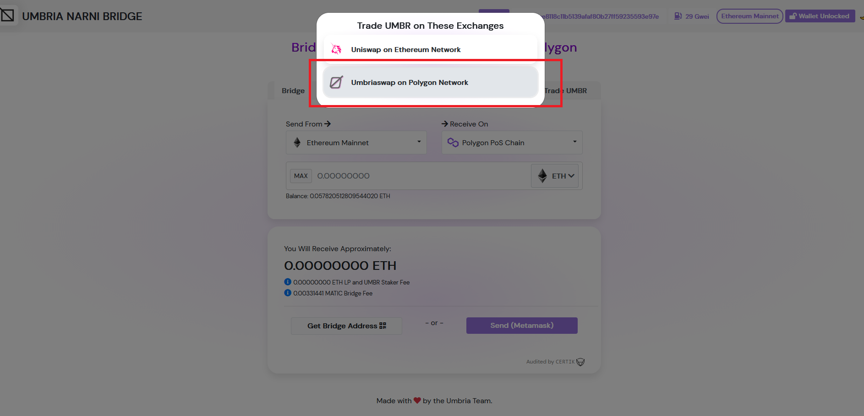
Link to the Umbriaswap on polygon does not work

Slide 23
UMBRIA
UX AUDIT REPORT
PAGE LAYOUT AND VISUAL DESIGN
The checkpoints in this area ask if the dialogue is aesthetic and minimalist. Appropriate visual design means that the fonts, icons, colours and layout help the customer complete common tasks and that pages do not contain information that is irrelevant or rarely needed.

Slide 24
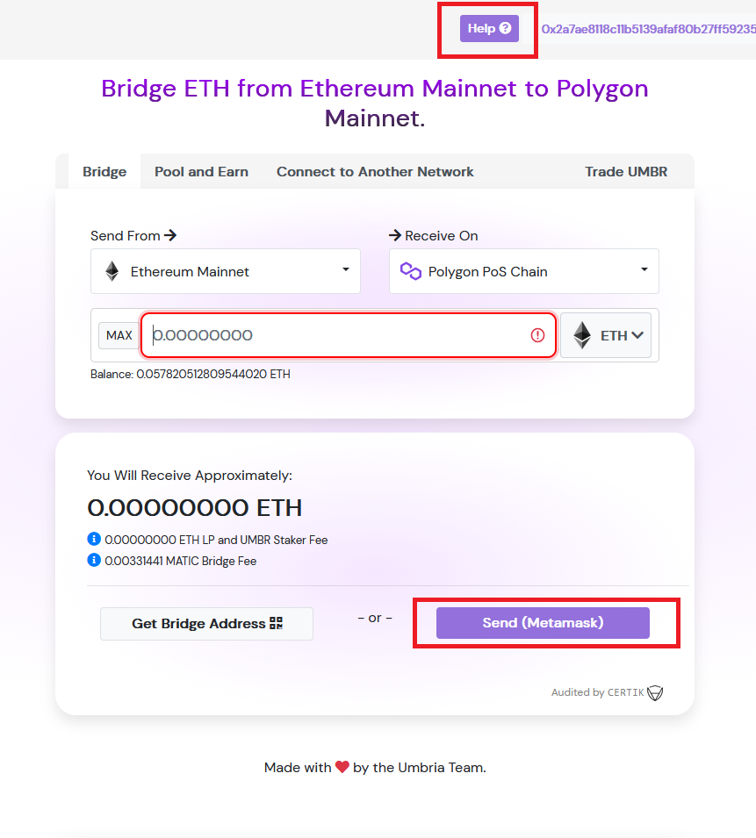
Issue (MEDIUM)
The current platform lacks the necessary visual cues to clearly indicate some clickable elements, such as buttons, causing confusion for users. Users are unable to easily distinguish between interactive and non-interactive elements, which impedes their ability to navigate and engage with the platform's features. Implement a consistent and distinct visual style for clickable elements, such as buttons
Recommendation
Implement a consistent and distinct visual style for clickable elements, such as buttons. Use contrasting colors, gradients, or shadows to make them stand out. Apply hover effects to clickable elements, such as changing the color or adding a subtle animation, to give users immediate feedback when hovering over them.
Buttons lacks the necessary visual cues (change of state on hover) to clearly indicate some clickability.

Slide 25
UMBRIA
UX AUDIT REPORT
WRITING AND CONTENT QUALITY
Writing for the web is not the same as writing for print: people read differently on the web and expect to scan content pages for information

Slide 26
Issue (LOW)
Recommendations
The platform exhibits shortcomings in maintaining concise text, as unnecessary instructions and welcome notes contribute to information overload and hinder user efficiency. Extraneous content may lead to cognitive strain, diminishing the clarity and simplicity of the user interface. This deviation from concise communication hampers the user experience by potentially overwhelming users with superfluous information."
Conduct a comprehensive content audit to identify and evaluate the necessity of each piece of text on the platform. Simplify and streamline instructions, removing redundant or verbose content to prioritize clarity and brevity.

Slide 27
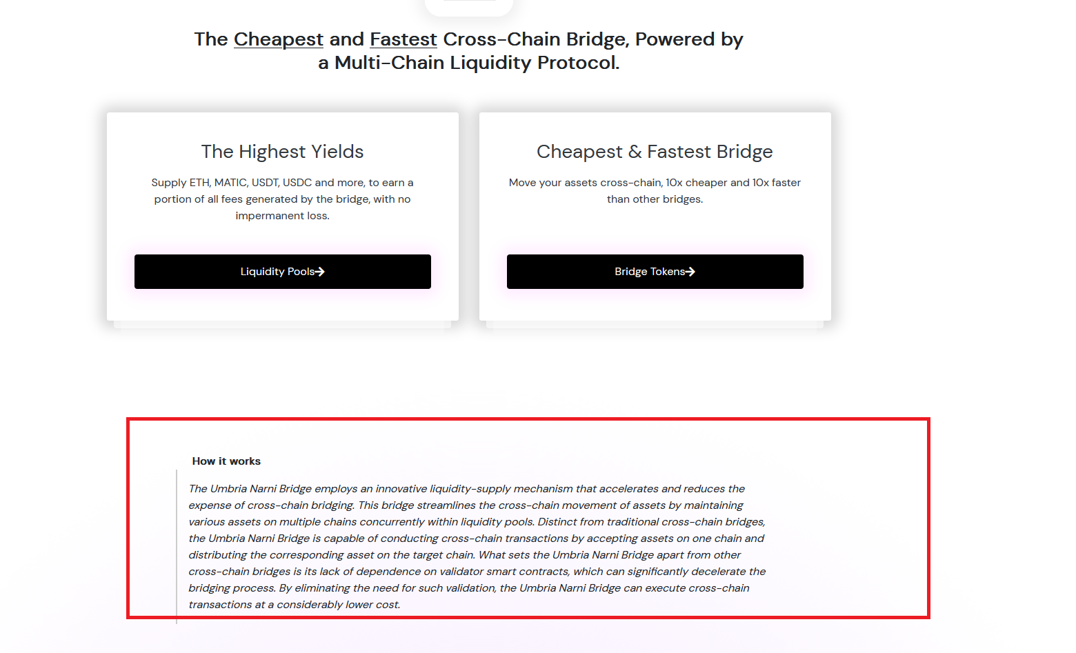
Simplify and streamline instructions, removing redundant or verbose content to prioritize clarity and brevity.

Slide 28
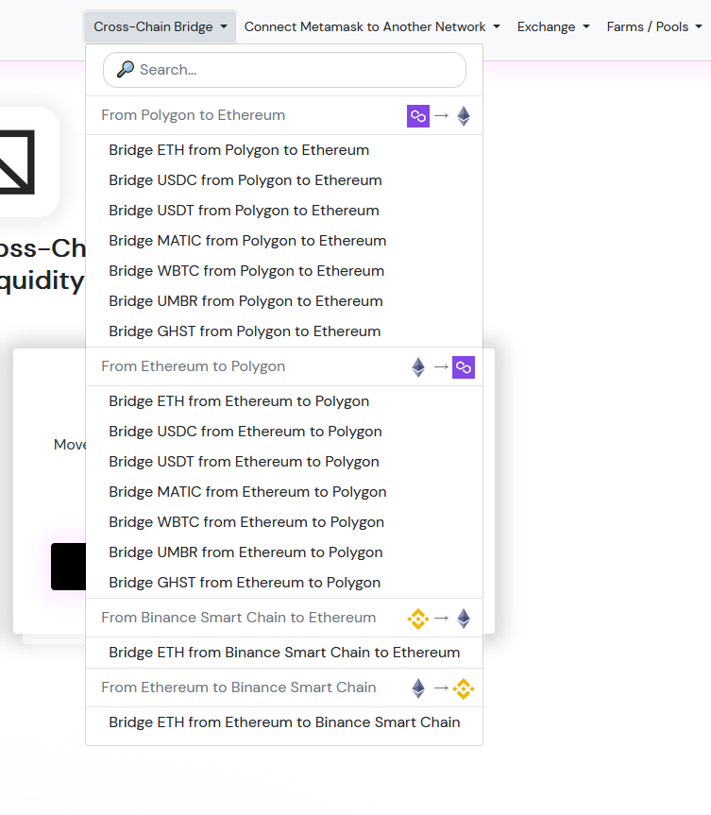
Maintain concise text to prevent information overload. This looks like too much info at first glance.

Slide 29
UMBRIA
UX AUDIT REPORT
PAGE LAYOUT AND VISUAL DESIGN
The checkpoints in this area ask if the dialogue is aesthetic and minimalist. Appropriate visual design means that the fonts, icons, colours and layout help the customer complete common tasks and that pages do not contain information that is irrelevant or rarely needed

Slide 30
Issue (LOW)
Recommendations
The current platform lacks the necessary visual cues to clearly indicate some clickable elements, such as buttons, causing confusion for users. Users are unable to easily distinguish between interactive and non-interactive elements, which impedes their ability to navigate and engage with the platform's features.
The current platform lacks proper visual feedback to indicate that buttons and links have been clicked, resulting in a deficiency in user experience. Users are unable to confidently discern whether their interactions have been registered, leading to uncertainty and potential frustration.
Implement a consistent and distinct visual style for clickable elements, such as buttons. Use contrasting colors, gradients, or shadows to make them stand out. Apply hover effects to clickable elements, such as changing the color or adding a subtle animation, to give users immediate feedback when hovering over them.
Implement subtle animation or color changes when buttons and links are clicked, providing immediate visual feedback that the interaction has been recognized, Change the appearance of buttons and links temporarily when clicked, such as altering the color or adding a shadow, to communicate the action's success.

Slide 31
Issue (LOW)
Recommendations
The platform faces readability issues in its font choices, impacting the overall user experience. The selected fonts fail to provide optimal legibility, potentially causing strain on users' eyes and hindering content comprehension. Poor readability may lead to increased bounce rates and user dissatisfaction, as users may find it challenging to consume information comfortably."
The platform demonstrates deficiencies in adhering to an underlying grid structure, resulting in inconsistent alignment of items and widgets both horizontally and vertically across pages. This lack of alignment undermines visual harmony, introduces a sense of disorder, and compromises the overall user experience. Users may find it challenging to navigate and engage with content cohesively, leading to potential confusion and a diminished perception of design professionalism.
Reevaluate and choose fonts that prioritize readability without sacrificing style. Opt for sans-serif fonts for online content and ensure that the font size is appropriate for comfortable reading, especially on smaller screens.
Grid System Implementation:Establish a robust grid system that guides the placement of items and widgets consistently across pages. Utilize a grid layout to ensure precise alignment, promoting a structured and visually cohesive design.
Consistent Margins and Padding:Enforce consistent margins and padding for elements within the grid. This helps maintain a sense of order, prevents overcrowding, and enhances the overall visual balance of the pages.
Column and Row Structure:Define a clear column and row structure within the grid, specifying the placement of items. Ensure that elements are arranged in a logical order

Slide 32
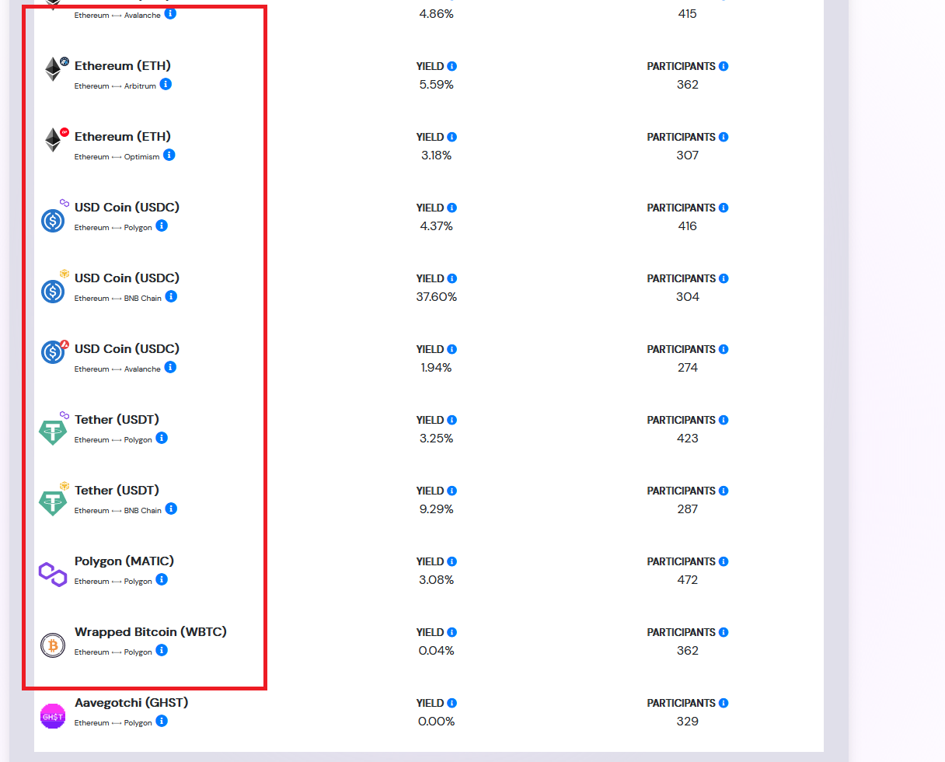
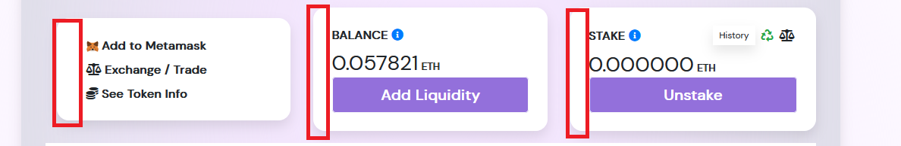
Table has has inconsistent padding giving the effect of a non vertical alignment.

Slide 33
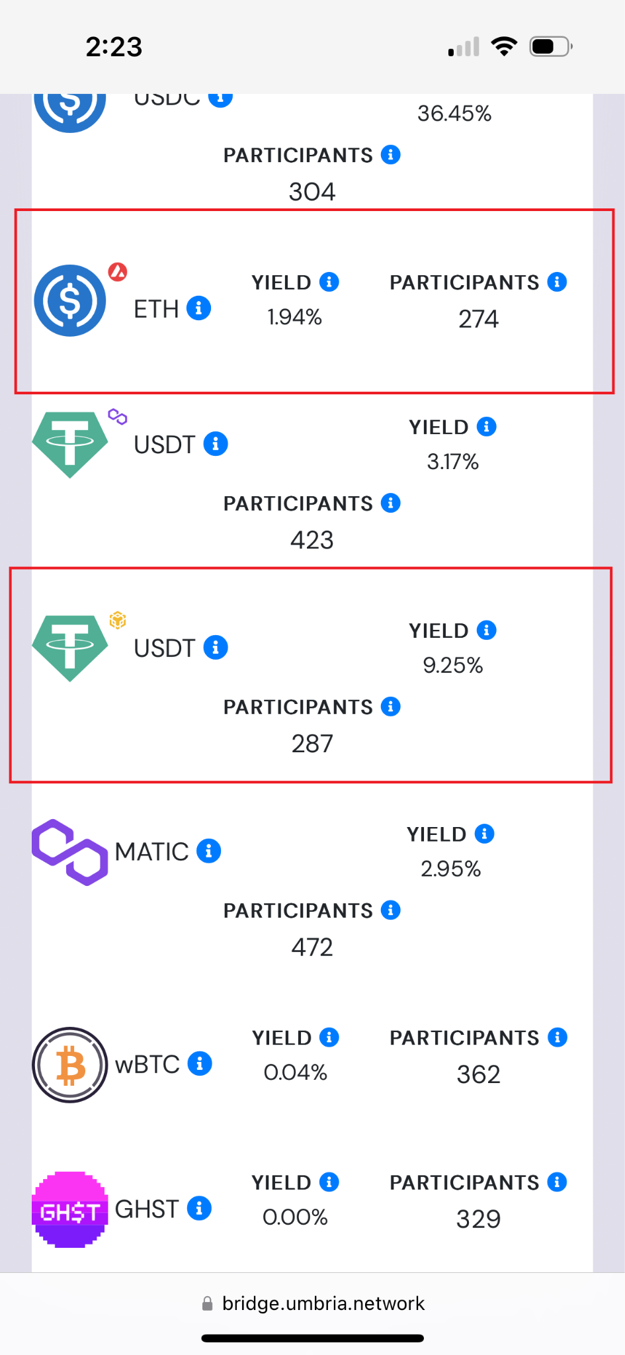
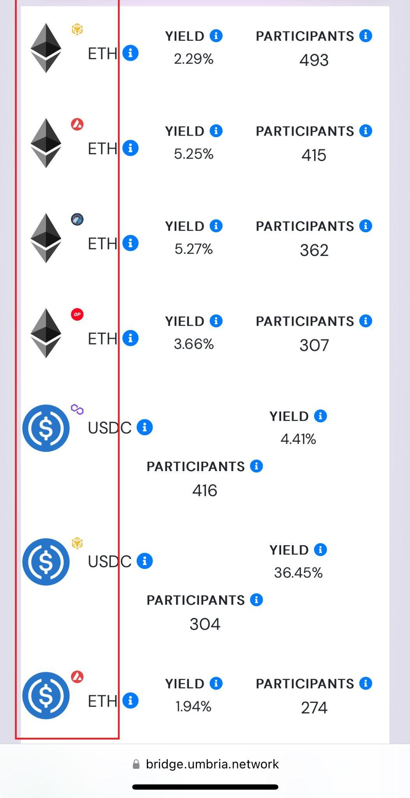
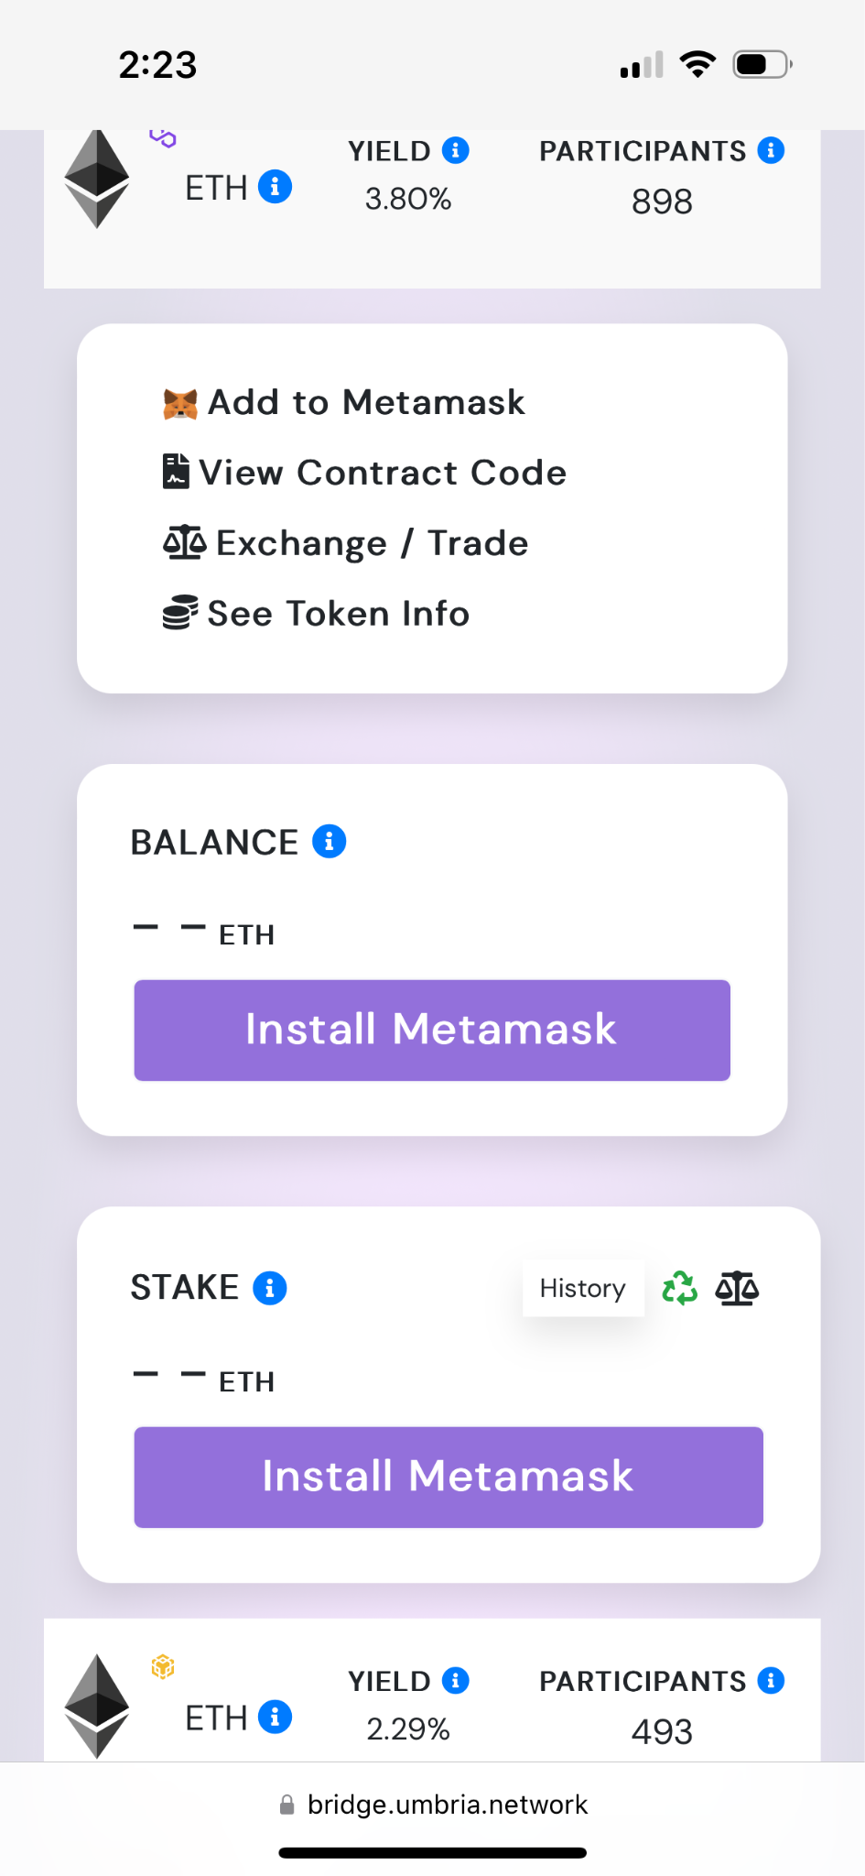
On Mobile view; Inconsistent paddings on cards elements, icons are not aligned and do not follow a consistent grid pattern

Slide 34
UMBRIA
UX AUDIT REPORT
ERRORS, HELP AND LEARNABILITY
These guidelines help assess if the site helps prevent customers from making errors. A site is error-tolerant if, despite evident errors in input, the intended result may be achieved with either no or minimal corrective action by the customer.
For novices and experts alike there should be readily available ways for them to become comfortable with using your product. Easy access to FAQs, onboarding etc.

Slide 35
Issue (MEDIUM)
Recommendations
The current platform fails to show users how to do common tasks, even where appropriate, resulting in a deficient user experience. Users lack access to demonstrations or tutorials that could guide them on utilizing the platform's functionality effectively, leading to frustration and reduced user engagement.
Develop an onboarding process that introduces users to the platform's key features and functionalities. Use interactive elements and informative screens to educate users on how to use the platform effectively. Use tooltips and pop-ups strategically to provide contextual guidance for specific actions. These informational cues should be unobtrusive but easily accessible to users who need additional help.

Slide 36
UMBRIA
UX AUDIT REPORT
TRANSPARENCY OF DATA PROVENANCE
Does the application clearly indicate which data comes from the blockchain and which does not?
Are the addresses of the contracts clearly stated?
Are all blockchain data linked to independent blockchain explorers?
Is it clear which data comes from oracles?

Slide 37
Issue (LOW)
Recommendations
Umbria does not clearly indicate which data originates from the blockchain and which data does not.
The Platform does not provide clear indications regarding the origin of data from oracles.
Improve Data Indication: Clearly differentiate between data originating from the blockchain and data from other sources.
Enhance Oracle Data Transparency: Clearly disclose the sources of data obtained from oracles, including information about the oracle providers, methodologies used, and data validation mechanisms.

Slide 38
TRANSPARENCY OF TRANSACTIONS
Are irreversible actions clearly indicated?
Are actions involving money or value clearly indicated?
Are actions that could potentially lead to user identification clearly indicated?
Are actions that generate new contracts in the user's name clearly indicated?
Does the application clarify and confirm the new future state in advance?
Is the data being used for a transaction shown in a human-readable format?
Are suggested values for gas price clarified and how to overwrite the transaction?
Is transaction wait time managed effectively

Slide 39
Issue (LOW)
Recommendations
Umbria fails to clearly indicate actions that could potentially lead to user identification. This lack of clarity raises significant concerns regarding user privacy and data protection.
Improve User Identification Disclosure: Clearly indicate any actions or processes that may result in user identification, ensuring users are informed about the potential risks and implications.

Slide 40
UMBRIA
UX AUDIT REPORT
TRANSPARENCY OF SMART CONTRACT EVENTS
Are all events, even those for developer purposes, clarified and made accessible to the end user?
Are interrupting messages shown only for information relevant to the current user?
Can users subscribe to, unsubscribe from, or temporarily mute certain events?

Slide 41
Issue (LOW)
Recommendations
The platform does not clarify or make all events, including those for developer purposes, accessible to the end user. This lack of transparency hinders users' understanding of the platform's operations and limits their ability to fully engage with the available functionalities.
Clearly indicate and make accessible all events, including those for developer purposes, to the end user. Providing users with visibility and clarity about system events will enhance their understanding of the platform's operations and empower them to make informed decisions.

Slide 42
UMBRIA
UX AUDIT REPORT
TRANSPARENCY AND ACCESSIBILITY OF USER’S INTERACTION HISTORY
Does the application provide a history of all transactions from a given address?
Is it clear where the history is stored (local or server)?
Are tools provided to navigate, search, export, and delete the history cache?

Slide 43
Issue (LOW)
Recommendations
The current platform fails to provide clarity on where the history is stored, whether it is stored locally on the user's device or on the server. This lack of transparency creates uncertainty for users, leading to concerns about data privacy, security, and the persistence of their historical activities on the platform.
Umbria does not provide users with the necessary tools to navigate, search, export, or delete the history cache. This lack of functionality restricts users from efficiently managing and leveraging their transaction history, impacting usability and user control.
Clear Data Storage Information: Clearly communicate to users whether their browsing history, preferences, or other data are stored locally on their device or on the server. This information should be presented in a prominent and easily accessible location, such as in the settings or account dashboard.
Introduce user-friendly tools to navigate, search, export, and delete the history cache.
These features will enable users to efficiently access and manipulate their transaction data, enhancing usability and user control.

Slide 44
UMBRIA
UX AUDIT REPORT
TRANSPARENCY OF CODE
Is it clear which blockchain is being used?
Are the addresses of the Smart Contracts used in read/write operations clarified?
Is it clear which code is open source and where to find it?
Is it clear where code is being run (local vs remote server)?
Is the web3 provider / Blockchain node clarified?

Slide 45
Issue (LOW)
Recommendations
Open-Source Code Clarity: It is not clear which code is open source and where to find it. This lack of transparency inhibits users from reviewing and validating the codebase, limiting their ability to assess security measures.
Code Execution Indication: The platform does not clearly indicate whether the code is being run locally on the user's device or on a remote server.
The platform does not make it clear which data originates from oracles or has been influenced by oracles.
Open-Source Code Disclosure: Clearly indicate which code is open source and provide accessible references to the code repository. Code Execution Visibility: Clearly communicate whether the code is executed locally or on a remote server, addressing concerns related to data privacy, security, and external dependencies.
Clearly indicate when data is sourced from or influenced by oracles. This transparency will empower users to differentiate between data from different sources.

Slide 46
UMBRIA
UX AUDIT REPORT
HUMAN READABLE HASHES FORMAT
Are compact versions of the hashes shown but always showing the initial and end parts?
Are users allowed to expand the full address/hash?
Can users easily copy it?
Is a custom human readable name or text associated with the addresses and hashes?

Slide 47
Issue (MEDIUM)
Recommendations
The platform falls short in presenting compact versions of hashes, as it neglects to consistently display the initial and end parts. The absence of this crucial information hinders users' ability to quickly recognize and verify the integrity of the hash. Without the inclusion of the initial and end parts, users may face challenges in confidently matching and confirming the authenticity of cryptographic hashes, potentially diminishing trust in the platform's security measures.
Umbria fails to provide users with the ability to expand the full address/hash. This limitation inhibits users from accessing and reviewing complete details.
Furthermore, the platform does not allow user to easily copy associated custom human-readable name or text with addresses and hashes.
Integrate a design solution that displays compact versions of cryptographic hashes, featuring the initial and end parts. This partial display helps users quickly identify and verify the hash without compromising security.
Implement an expandable feature that allows users to view the full address or hash on the platform. When users encounter truncated addresses or hashes, they should have the option to click or tap on the shortened version to reveal the complete string.
Implement a user-friendly copy functionality for addresses and hashes. This functionality should be easily accessible and allow users to quickly copy the information with a simple action.

Slide 48
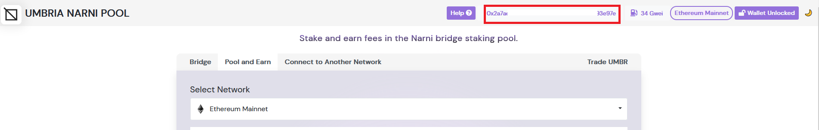
The platform falls short in presenting compact versions of Addresses as it neglects to consistently display the initial and end parts. Also, Implement a user-friendly copy functionality for addresses.

Slide 49
UMBRIA
UX AUDIT REPORT
PERMANENT NEWBIE MODE
Is educational information woven into normal interaction?
Are there 2 or more levels of educational content: Blockchain basics and Dapp specific lingo?
Is the amount of new things and concepts that the user needs to learn minimized and increased progressively?

Slide 50
Issue (MEDIUM)
Recommendations
Umbria fails to effectively weave educational information into normal interactions.
Moreover, the platform does not minimize the amount of new things and concepts that users need to learn, nor does it progressively increase the complexity of educational content, making it challenging for users to grasp unfamiliar concepts.
Integrated Educational Content: Integrate educational information seamlessly into normal interactions, providing users with relevant explanations, tooltips, or guided tutorials that enhance their understanding of the platform's features and processes.
Multi-Level Educational Resources: Develop two or more levels of educational content, including blockchain basics and Dapp-specific lingo, to cater to users with varying levels of familiarity. These resources should cover essential concepts, terminologies, and best practices to empower users to make informed decisions..

Slide 51
UMBRIA
UX AUDIT REPORT
GAS PRICE AND TRANSACTION REVERSAL
Is what Gas and Gas price clarified?
Are gas prices ranges suggested and time approximations for the upper and lower bounds clarified?
Are transaction reversals allowed?

Slide 52
Issue (MEDIUM)
Recommendations
The current platform fails to clarify what Gas and Gas price are, resulting in a deficient user experience. Users are left without clear explanations or relevant information about these terms, leading to confusion and potential obstacles in their interactions with the platform
Gas Price Ranges and Time Approximations: The platform does not suggest gas price ranges or provide time approximations for the upper and lower bounds. This absence of information makes it challenging for users to estimate transaction costs and plan their interactions accordingly. Clear suggestions and time approximations would help users make informed decisions based on factors like network congestion and gas fees.
Provide a clear and concise explanation of what Gas and Gas price are in the context of the platform. Use user-friendly language and avoid technical jargon to ensure the information is easily understood by all users.
Gas Price Ranges and Time Estimates: Suggest gas price ranges and provide time approximations for the upper and lower bounds. This information will assist users in estimating transaction costs and better planning their interactions based on network conditions and gas fees.

Slide 53
UMBRIA
UX AUDIT REPORT
USABILITY SCORE

Slide 54
153 /183
GOOD
Users should be able to use this site or system with relative ease and should be able to complete the vast majority of important tasks.
USABILITY SCORE
Ultimately, the usability score is a quantitative or qualitative representation of how usable and effective a product is in meeting user needs and goals. It helps evaluate the success of UX design and identify areas for improvement to enhance the overall user experience.

Slide 55
UMBRIA
UX AUDIT REPORT
NEXT STEPS

Slide 56
NEXT STEPS
Suggestions to improve the Umbria experience
#1
Incorporate Newbies in Product Roadmap -
Switch from focusing on product development for just veteran users of the blockchain and involve newbie users in developing a user-centric product.
#2
Implement Findings -
follow up the Implementation of the Research Findings on live platform.

Slide 57
UMBRIA
UX AUDIT REPORT
RESOURCES

Slide 58
SOURCES
Explore attached Unabridged UX audit detailed findings on Umbria
Expert Review Based On web Usability Guidelines Spreadsheet report
Expert review based on Web3 UX Principles by Beltran Spreadsheet report
Expert review collation and usability score report on Airtable spreadsheet Report

Slide 59



www.generalmagic.io

